Slide 1
Chapter 11

Slide 2
Objectives

Slide 3
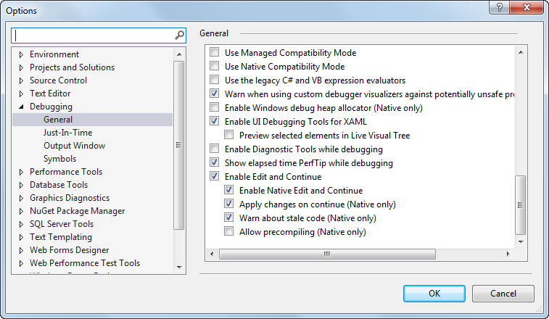
The Options dialog box

Slide 4
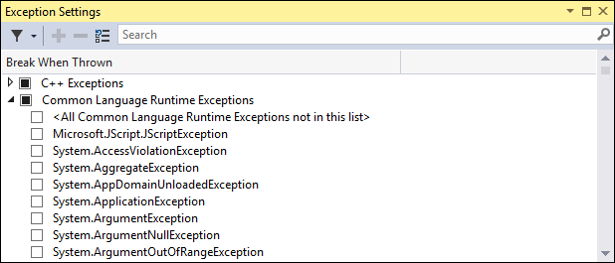
The Exception Settings window

Slide 5
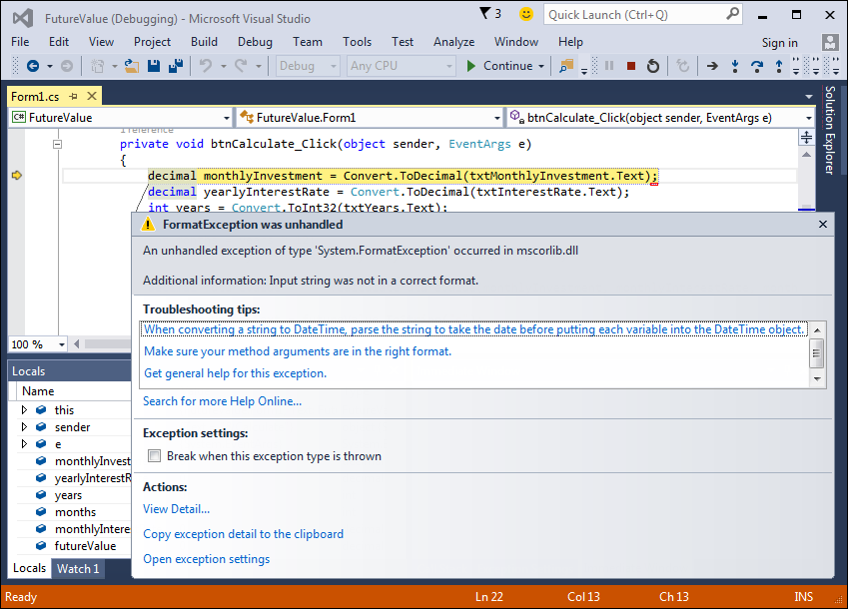
The Future Value application in break mode

Slide 6
Four ways to enter break mode

Slide 7
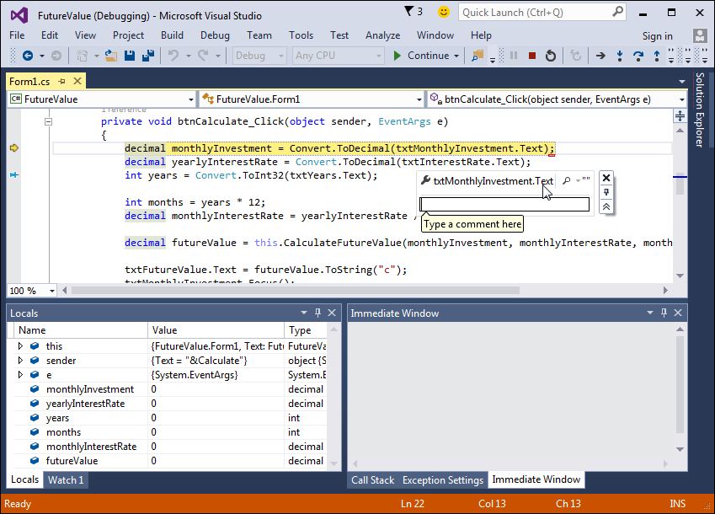
The Future Value application with a data tip displayed

Slide 8
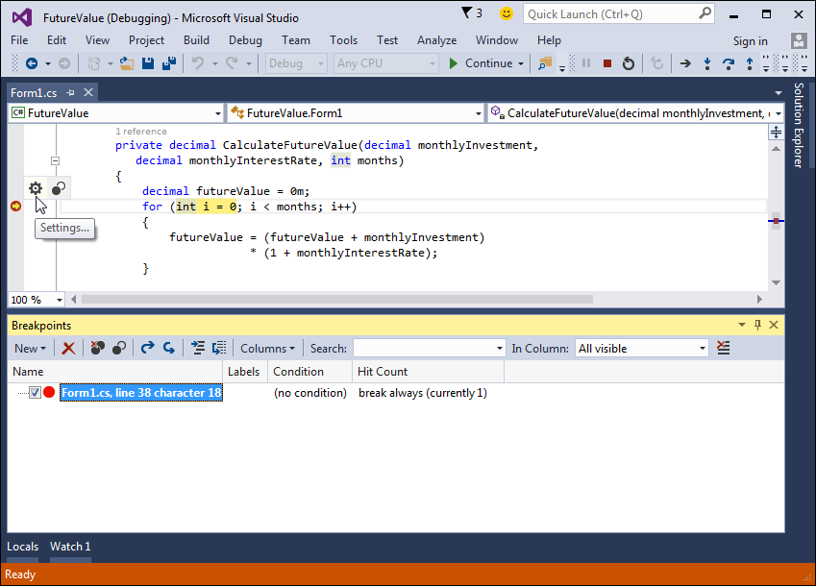
The Future Value application with a breakpoint

Slide 9
How to set and clear breakpoints

Slide 10
Commands in the Debug menu and toolbar

Slide 11
Commands in the Code Editor’s shortcut menu

Slide 12
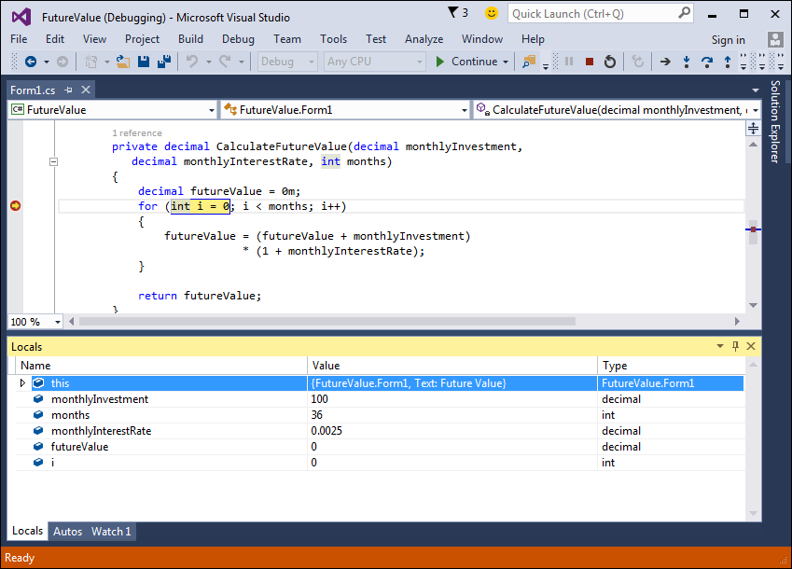
The Locals window

Slide 13
How to use the Locals window

Slide 14
How to use the Autos window

Slide 15
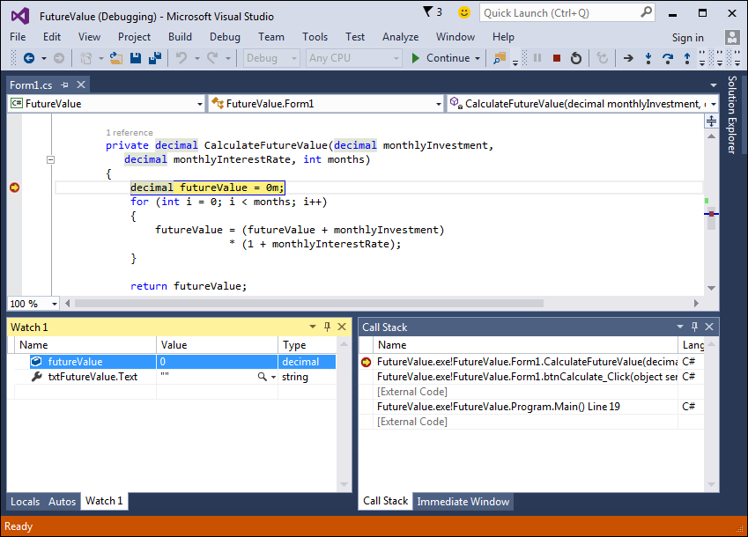
A Watch window

Slide 16
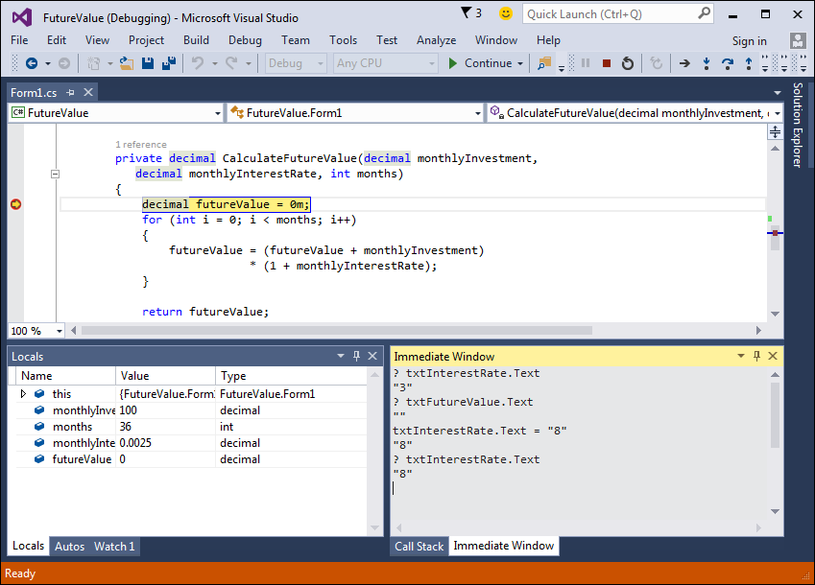
The Immediate window

Slide 17
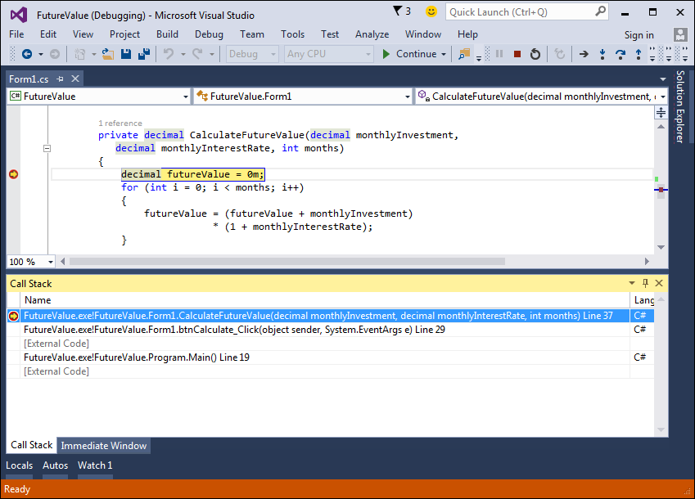
The Call Stack window

Slide 18
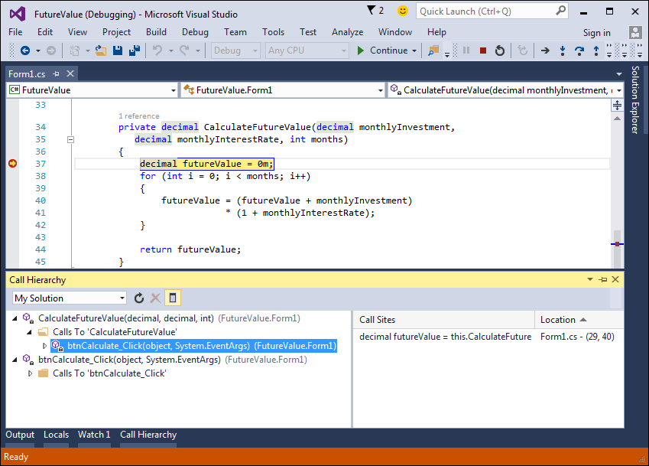
The Call Hierarchy window with two methods displayed

Slide 19
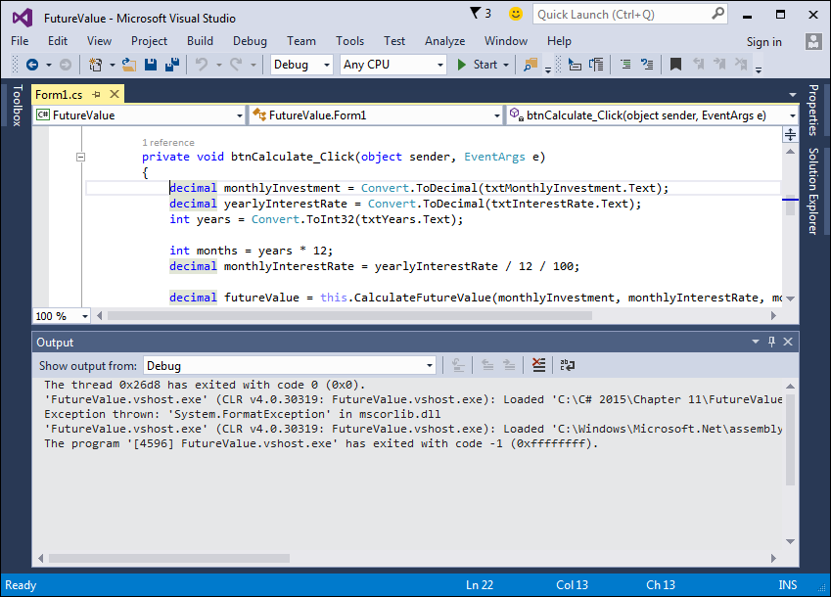
An Output window that shows debug information

Slide 20
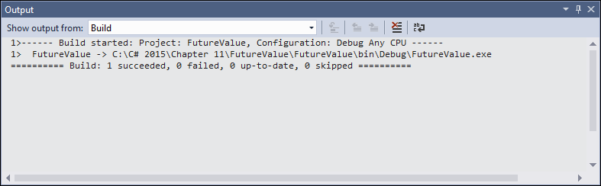
An Output window that shows build information

Slide 21
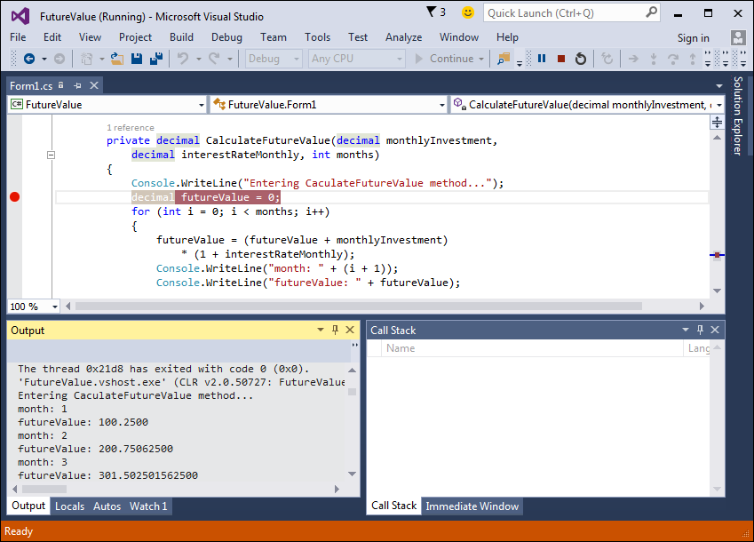
An Output window with debugging information

Slide 22
Methods of the Console class that write data to the Output window

Slide 23
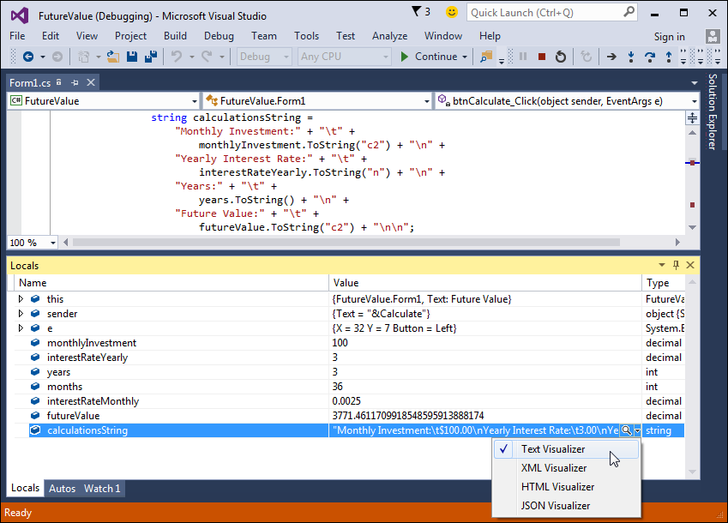
The Visualizer menu in the Locals window

Slide 24
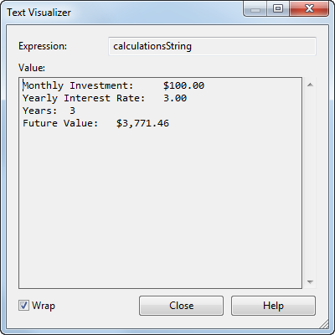
The Text Visualizer dialog box

